Slide 1
Impact of Delivery Delays on Customer Satisfaction
Data Storytelling & Statistical Validation
Project: E-Commerce Order Fulfilment Efficiency Analysis

Slide 2
Business Problem
Business Context
Delivery performance strongly influences customer satisfaction in e-commerce.
Key Question
Do late deliveries significantly reduce customer review scores?
Objective
Validate impact using statistical hypothesis testing.
Business Impact
Lower ratings
Customer churn risk
Negative brand perception
Operational improvement opportunity

Slide 3
Dataset Overview
Total Orders
96,353
Late Orders
6,409
On‑Time Orders
89,944
Key Dataset Facts
Late delivery rate: 6.6%
Analysis based on 96K delivered orders
Includes customer review ratings

Slide 4
Hypothesis Testing
H0: No significant difference in ratings
H1: Late deliveries have lower ratings
Test: Independent T-Test
Significance level: 0.05

Slide 5
Key Results
Late Delivery Rating
2.27
On-Time Delivery Rating
4.29
Rating Gap
2.02
Key Insight:
On-time deliveries receive ~2 point higher ratings.
Statistical Result:
Difference is statistically significant (p < 0.05).

Slide 6
Statistical Validation
T-Statistic: -132.07 P-Value: < 0.0001
Decision: Reject Null Hypothesis
Conclusion: Late deliveries significantly reduce ratings.

Slide 7
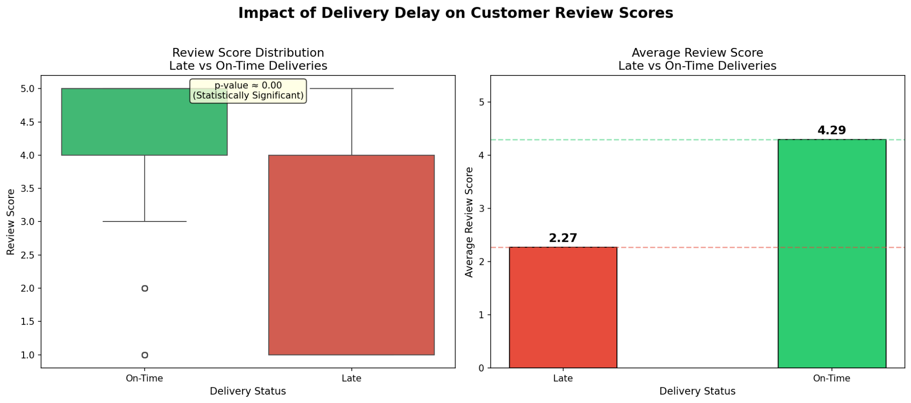
Key Insight Visualization

Slide 8
Business Insights
Late deliveries damage customer experience
Delivery reliability drives satisfaction
Logistics efficiency impacts retention

Slide 9
Recommendations
Improve logistics
Predict delays
Notify customers
Offer compensation
Monitor partners

Slide 10
Conclusion
Late deliveries reduce ratings by 2.02 points
Result statistically significant (p < 0.05)
Delivery performance directly affects satisfaction
Improving logistics can improve retention.

